Slide 1

MSCI 311
Organizational Design and Technology
Instructor: Ayman Alzayat, aalzayat@uwaterloo.ca
TA: Varsha Suryanarayana, vsuryana@uwaterloo.ca

Slide 2
Understanding Organizational Theories
INTRODUCTIONS
Expectations (Mine & Yours)
Course Information and Assessments
Organizations: Definitions and Theories

Slide 3
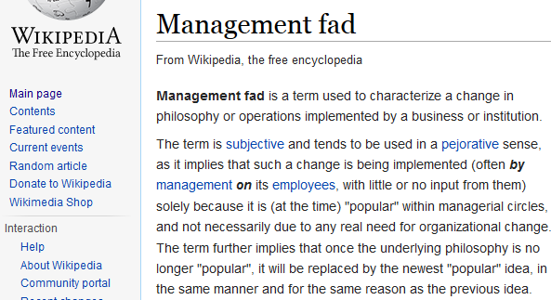
LECTURE 2 Understanding Organizational Theories
Organizations are ‘man-made’, and not the result of a natural evolution.
Example, management ‘fads’
Management by Objectives
Knowledge Management
Six Sigma
Lean

Slide 4
Research Considerations
What is the focus?
Focus on internal (e.g., employees)
Focus on external environments (e.g., markets)
Markets
Government
Competitors
Upper management
Engineering
Engineering Services
Research & Development
Production
Production
Customers
Suppliers

Slide 5
Understanding Organizational Theories - Research Considerations
Unit of analysis: the fundamental element of interest or objects of study within a research project.
Important to find the most suitable unit of analysis depending on what the research question is.
Focus of the theoretical attention
For example, social interaction

Slide 6
Understanding Organizational Theories - Research Considerations
Exercise: What might be the unit of analysis (e.g., employees, departments, or organizations) in researching the following questions?
What is the effect of market uncertainty on organizational productivity?
What ‘roles’ do participants take in organizational decision making?
Can a better work-life balance motivate employees to work harder?

Slide 7
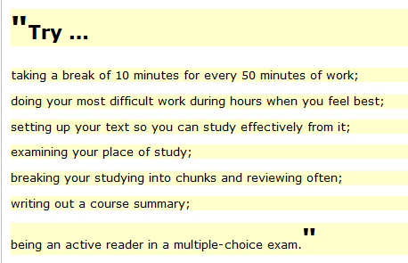

Understanding Organizational Theories - Research Considerations
Prescriptive (how to do it) vs. descriptive (how it’s done) analysis.
Example: studying behaviour
Prescriptive
Descriptive

Slide 8
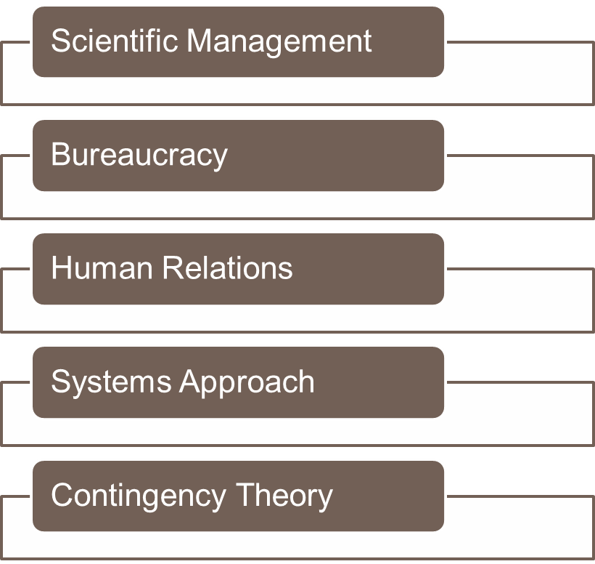
Organizational Theories and Approaches
Classical
Classical

Slide 9
Scientific Management
History
Internal environment
Unit of analysis: steps in performance of a simple physical task
Prescriptive

Slide 10
Scientific Management
Problems with this approach:
Limited applicability
Physical vs. cognitive tasks
Individual vs. group tasks
Undesirable consequences of optimization
Repetitive work
Loss of autonomy

Slide 11
BUREAUCRACY
Questions
What words come to mind when you think about bureaucracy?
Have you worked in a place that you would think of as a bureaucracy? What are its characteristics?
What are the positive/negative aspects of bureaucracy?

Slide 12
BUREAUCRACY
Unit of Analysis: offices and procedures
Mainly Prescriptive Approach
Internal focus

Slide 13
BUREAUCRACY
Problems with Bureaucracy
Org. as a machine or a rational system.
Appropriateness of the rules.
Example: buses on the railroad crossings.
Ease of changing rules when necessary.
Hierarchical communication & decision making.

Slide 14
HUMAN RELATIONS
Existence of informal organization (social organization) with its own norms, values, and expectations.
Internal environment
Unit of analysis: individual & small group behavior
Example: individual attitude, small group decision making
Descriptive

Slide 15
HUMAN RELATIONS
Problems with Human Relations
assumes organization equals the sum of all people
assumes job satisfaction ~ productivity

Slide 16
SYSTEMS VIEW
Borrowing from the natural sciences
System: a complex unity of things that are interconnected and interdependent
Unit of analysis: cycle of events
Internal and/or external (can be applied at different levels of analysis)
Descriptive

Slide 17
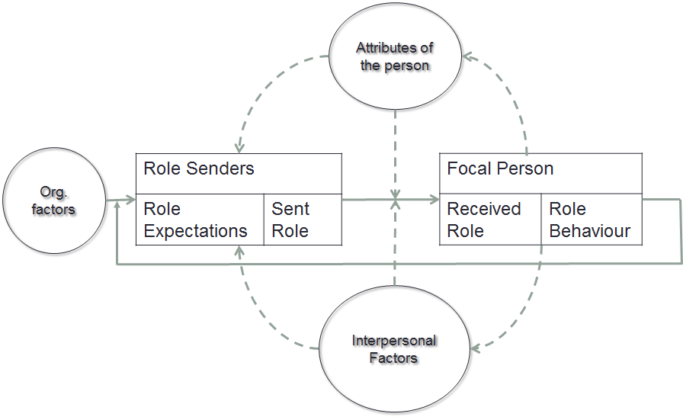
SYSTEMS VIEW
Role-taking Model, Katz & Kahn

Slide 18
SYSTEMS VIEW
Problems with the system approach
Selecting the appropriate level of analysis
Example: individual, work group, department
From abstract concepts to specific cycle of events
Example: feedback in the role model
Complexity of application

Slide 19
Contingency Theory
Organizational design depends on context
Just like human behaviour = f (person & situation), organizational structure = f (internal & external factors)
Unit of analysis: relationship between organization design and certain “contingency” variables (environment, technology, size, age, etc.)
Internal and external
Descriptive

Slide 20
Contingency Theory
Problems with the Contingency Theory
Did not develop a comprehensive theory
e.g treated each variable separately.
Not applying the same kind of analysis at different level
e.g impact on departments

Slide 21
Summary
Defining organizations
By categorization, by goals..
Patterns of behavior resulting from formal and informal constraints
Tools in studying organizations
Environment: Internal vs. External
Units of Analysis
Analysis: Descriptive vs. Prescriptive
Some major organizational theories
Scientific management
Bureaucracy
Human relations
Systems view
Contingency theory

Slide 22
CA1
What is the unit of analysis for Scientific Management? Give an example.
What is the unit of analysis for Human relations? Give an example.
Discuss the differences between prescriptive vs. descriptive analysis. Give an example for each way of analysis different from the lecture.
Should submitted by tomorrow (Friday the 14th) 11:30 pm to drobox in Learn.

